Slide 1



Software Engineering CS411, FALL 2025
Lecture 7: Design Principles I by Dr. Mohamad Kassab
Leonidas Kontothanassis kthanasi@bu.edu

Slide 2

Lesson plan
Introduce you to the Operations Contract for External Operations.
Talk about Software Architectures
GRASP Patterns:
Expert
Creator
Controller
Low Coupling/High Cohesion
Polymorphism
Pure Fabrication
Indirection
Don’t Talk to Strangers (Law of Demeter)
We focus on these two in this lecture,
and we will keep the remaining for the next lecture.

Slide 3
GOAL
Domain Model
+
Sequence Diagrams
+
Operation Contracts
Class Diagram
+
Interaction Diagram

Slide 4
Operation Contracts

Slide 5

System Operation Contracts
Documents operations a system must perform.
For each operation, documents:
What the operation commits to achieve
An operation’s pre and post conditions

Slide 6
System Operation Contracts
Notes:
Operation contractions use a pre and post condition form to describe detailed changes to objects in a domain model
To create a contract – identify the system operations from the system sequence diagram

Slide 7
System Operation Contracts
To create a contract
Identify operations from System Sequence Diagrams (SSDs)
For each operation, write:
Responsibilities (purpose of operation)
Pre-Conditions (state of the system before execution of the operation)
Post-Conditions (state changes to objects in the domain model, e.g., instance creation/deletion; attribute modification, association creation/deletion)
Notes:
Association – path messages are sent

Slide 8
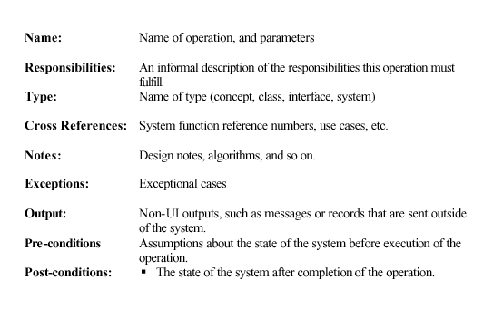
Operation Contract Full Template
Notes:
Name: As explained in slide
Type: The class that receives the message associated with the operation and is responsible for bringing it to completion. In some cases this could be the system itself.

Slide 9
Operations Contract
When we assign the post conditions, we can be inspired by looking into the domain model that we already created, and ask our selves:
Which instances (objects) will be created when the external operation enters the system?
Which Associations will be formed when the external operation enters the system?
Which attributes will have their values modified when the external operation enters the system?

Slide 10
Example: Domain Model for Point of Sale (PoS System)
Records-sale-of
Described-by
1
Product
Product
Specification
Catalog
Contains
1
1..
*
description
price
1
UPC
0..1
*
Used-by
Describes
Sales
*
*
LineItem
Store
Item
Stocks
quantity
1
address
1
*
1
*
name
1..
Contained-in
Logs-
1
Houses
completed
*
1
6
1..
Sale
*
register
Started-by
Manager
date
1
1
Captured-on
time
1
1
1
1
Initiated-by
1
Paid-by
3
Records-sales-on
1
1
1
Payment
Customer
Cashier
amount
Notes:
Multiplicity – defines how many instances of class A can be associated with class B
Single instance of store can be associated with “many” (zero or more, indicated by the *) Sale instance

Slide 11
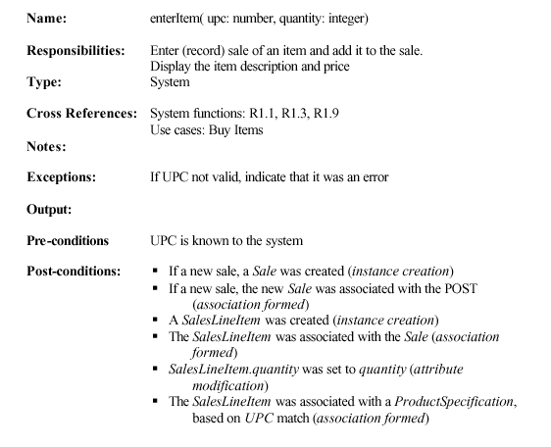
Example (Operation Contract for enterItem)

Slide 12
In Practice: When to write operations contracts
Complex or Critical Operations: If an operation involves complex logic, significant side effects, or critical business rules, a detailed contract can serve as a guide for implementation and testing.
When It May Not Be Necessary:
Trivial or Internal Operations: For simple, self-contained operations (especially those that are internal helpers or that have obvious behavior), a full formal contract might be overkill.
Low-Risk Operations: If an operation’s behavior is straightforward and unlikely to cause issues, you might choose to document it more informally or rely on clear code implementation instead of a formal contract.

Slide 13

Software Architecture Styles
Data Centered
Data Flow
Call and Return
Object Oriented
Layered
A system may use a combination of the styles.

Slide 14
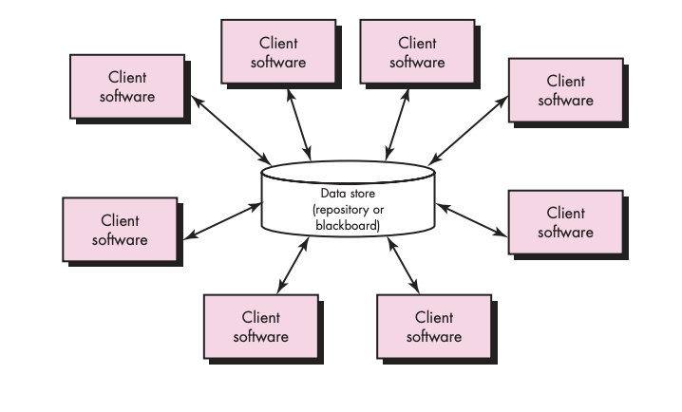
Data Centered Architecture
Notes:
Central Data Store (might be passive or active). Client software decides on actions independently based on state of data. Avoid race conditions. Also pub/sub on data modifications. Scaling can be a problem.

Slide 15
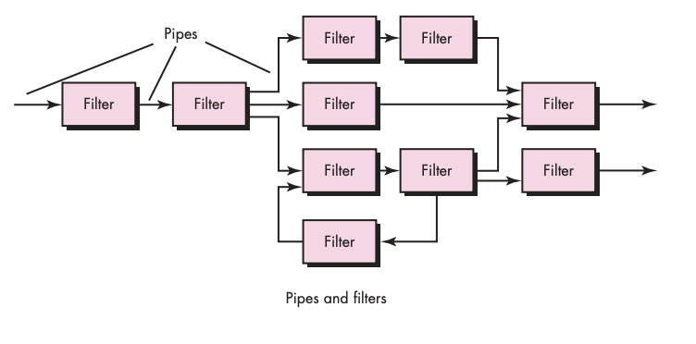
Data Flow Architecture
Notes:
Useful when the purpose of the system is to transform a continuous (or finite) set of data through a series of transformations.

Slide 16
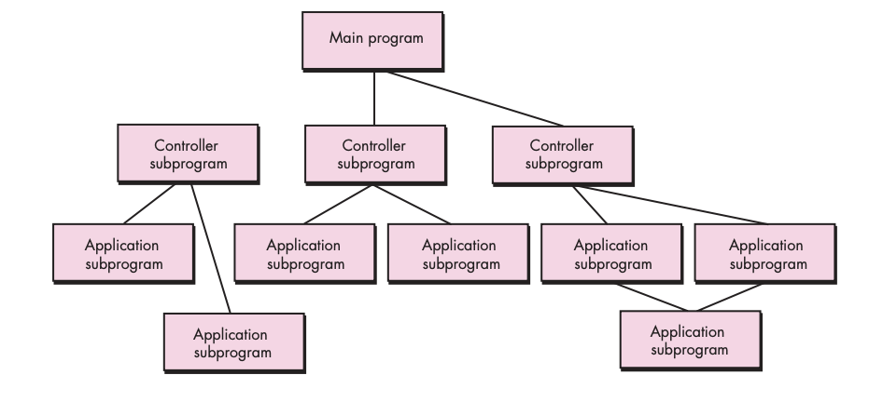
Call and Return Architecture
Notes:
Main program with subprograms. Also useful in the context of RPC.

Slide 17
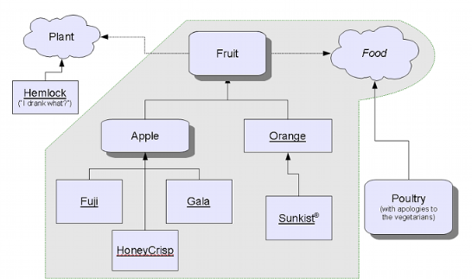
Object Oriented Architecture
Notes:
Main focus of this is the class. Encapsulation, inheritance, abstraction. GRASP patterns for class creation and manipulation.

Slide 18
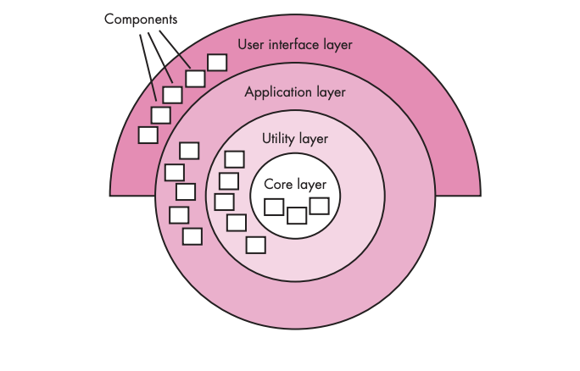
Layered Architecture
Notes:
Each layer provides some functionality with outer layers calling through the layer below. Do not skip layers! Very useful in OS design, Networking design, systems that have a strong HW component.

Slide 19
GRASP PATTERNS for OO Design

Slide 20

GRASP: Patterns of General Principles in Assigning Responsibilities
General
Responsibility
Assignment
Software
Patterns.
Provide guidance for assigning responsibilities to classes and, to limited extent, determining classes that will be in a design.
Notes:
The grasp principles or patterns are a learning aid to help you understand essential object design and apply design reasoning in a methodical, rational, explainable way

Slide 21
A Responsibility
“A contract or obligation of a type or class”
UML User Guide
Responsibilities can be one of two basic types:
Doing
A Sale is responsible for printing itself
Knowing
A Sale is responsible for recording its date
Responsibilities are not methods…the responsibility to provide access to relational databases is more than a single method…more than a single class!
Notes:
A responsibility is also an abstraction of the object does
Two types of responsibilities: doing and knowing.
May seem contradictory that it is an obligation of a class but can also span classes. Some responsibilities are very broad and may span the system as a whole. Example borrow books from a Library. Those should be broken down to small responsibilities that can be an obligation of a single class.

Slide 22

“Doing” responsibilities
An object:
Doing something to itself
Initiating action in other objects
Controlling and coordinating activities in other objects

Slide 23

“Knowing” responsibilities
An object:
Knowing about private encapsulated data
Knowing about related objects
Knowing about things it can derive or calculate.

Slide 24

GRASP Patterns
Expert
Creator
Low Coupling/High Cohesion
Controller
Polymorphism
Pure Fabrication
Indirection
Don’t Talk to Strangers (Law of Demeter)
Notes:
Demeter is a greek goddess.
“distribution-mother” and goddess of agriculture, to signify a bottom-up philosophy of programming which is also embodied in the law itself.
Limit how many classes you get to talk to. Even if it may seem easy to call the public method of some class, if you only need to talk to it rarely perhaps you can find a go-between that you talk to it frequently and it talks to the other one frequently to broker the conversation.

Slide 25
Grasp Patterns Summary
Pattern | Problem It Solves | Solution (Responsibility Assignment)
Information Expert | Who should be responsible for a behavior? | Assign to the class that has the necessary information.
Creator | Who should create a new object? | Assign creation to a class that aggregates, closely uses, records, or has init. data.
Controller | Who handles a system event (use case input)? | Assign to a controller class representing the system or a use case.
Low Coupling | How to reduce dependency between classes? | Assign responsibilities to keep dependencies minimal.
High Cohesion | How to keep classes focused and manageable? | Assign related responsibilities together; avoid unrelated ones in the same class.
Polymorphism | How to handle behavior that varies by type? | Assign responsibility for variant behavior to the type that varies, using polymorphism.
Pure Fabrication | What if assigning to a real class hurts cohesion/coupling? | Create a made-up class to take the responsibility.
Indirection | How to avoid direct coupling between two elements? | Assign responsibility to a mediator class that decouples them.
Law of Demeter | How to prevent “train-wreck” chains of calls and fragile coupling | A method should only talk to its immediate collaborators (self, fields, parameters, new objects).

Slide 26
What is a Pattern?
General principles and solutions to guide developers in the creation of software
The pattern is named and documented in a structured format describing the problem and solution
The pattern can be applied to a new context
Contains advice on how to apply it in a novel situation, discusses trade-offs, implementations, and variations.

Slide 27

EXPERT PATTERN

Slide 28
Expert…
Intent:
Assign a responsibility to the information expert – the class that has the information necessary to fulfill the responsibility.
“That which has the information, does the work.”
Notes:
AKA Information Expert

Slide 29
…Expert
Problem:
What is most basic, general principle of responsibility assignment?
A class model may define hundreds of software classes, and an application may require thousands of responsibilities to be fulfilled.
During OOD we make decisions about the assignment of responsibilities.
Done well, systems tend to be easier to understand, maintain, and extend.

Slide 30
Example: Class Diagram
Records-sale-of
Described-by
1
Product
Product
Specification
Catalog
Contains
1
1..
*
description
price
1
UPC
0..1
*
Used-by
Describes
Sales
*
*
LineItem
Store
Item
Stocks
quantity
1
address
1
*
1
*
name
1..
Contained-in
Logs-
1
Houses
completed
*
1
1..
Sale
*
register
Started-by
Manager
date
1
1
Captured-on
time
1
1
1
1
Initiated-by
1
Paid-by
3
Records-sales-on
1
1
1
Payment
Customer
Cashier
amount
Notes:
Multiplicity – defines how many instances of class A can be associated with class B
Single instance of store can be associated with “many” (zero or more, indicated by the *) Sale instance

Slide 31
Expert – example…
In a point-of-sale terminal application, some class needs to know the grand total of a sale.
By Expert, the class that has the information needed to determine total should have that responsibility.
1
Notes:
Ask “who should be responsible for knowing the grand total of a sale?”
Here is a partial domain model showing the “associations” of Sale
Go to the next slide to figure out what is needed to determine the grand total.

Slide 32
…Expert – example…
What info is needed?
Needs to know about all SaleLineItem instances and the sum of their subtotals.
Only Sale knows this, so has responsibility.
Notes:
It is necessary to know about all the saleslineitem instances of a sale and the sum of their subtotals. Sale knows theses – by the Expert guideline, Sale is a suitable class for this responsibility.
Partial Interaction and class diagrams shown here – showing where you would assign the responsibility – Sale has the method total() and Sale is getting a message requesting that information.

Slide 33
…Expert – example…
But what is responsible for subtotal?
Need SalesLineItem.quantity and ProductSpecification.price, so SalesLineItem is responsible.
t := total()
1*: sli := subtotal()
:Sale
Sale
date
time
total()
:SalesLineItem
SalesLineItem
quantity
New method
subtotal()
Notes:
What information is needed to determine the line item “subtotal”?
SalesLineItem knows its quantity and its associated product specification (price) (look at slide 11)
Therefore by “expert”, salesLineItem should determine the subtotal. It is the information expert.

Slide 34
…Expert – example…
And finally,
t := total()
:Sale
Sale
date
time
1*: st := subtotal()
total()
:SalesLineItem
SalesLineItem
quantity
1.1: p := price()
subtotal()
:Product
Product
Specification
Specification
description
price
UPC
New method
price()
Notes:
To fulfill the responsibliity of knowing and answering its subtotal, a sales lineitem needs to know the product price.
The productSpecification is an information expert on answering the price; therefore a message must be sent asking for the price
SO – to fulfill the responsibility of knowing and answering the sale’s total, 3 responsibilities were assigned to three design classes of objects:sale (new the sale total), SalesLineItem (knows line item subtotal), ProductSpecification (knows product price)

Slide 35
Expert
Consequences:
Encapsulation is maintained so supports low coupling.
Behavior distributed encouraging cohesive “lightweight” classes.
Notes:
Low coupling – leads to more robust and maintainable systems
Lightweight – easier to understand

Slide 36

CREATOR PATTERN

Slide 37
Creator
Intent:
Assign class B the responsibility to create instance of class A if one of the following is true:
B contains or aggregates A
B closely uses A
B has the initializing data for A
If more than one option applies, prefer class B which contains or aggregates A.
Notes:
Aggregates – to gather as a whole
Multiple classes could qualify. Favor the one with stronger ownership/aggregation.
Next favor that which has more of the information needed locally
Favor low coupling/high cohesion (more on that later).

Slide 38
…Creator
Problem:
Who should be responsible for creating new instances of some class?
Notes:
Multiple classes could qualify. Favor the one with stronger ownership/aggregation.
Next favor that which has more of the information needed locally
Favor low coupling/high cohesion (more on that later).

Slide 39
Example: Domain Model Diagram
Records-sale-of
Described-by
1
Product
Product
Specification
Catalog
Contains
1
1..
*
description
price
1
UPC
0..1
*
Used-by
Describes
Sales
*
*
LineItem
Store
Item
Stocks
quantity
1
address
1
*
1
*
name
1..
Contained-in
Logs-
1
Houses
completed
*
1
6
1..
Sale
*
register
Started-by
Manager
date
1
1
Captured-on
time
1
1
1
1
Initiated-by
1
Paid-by
3
Records-sales-on
1
1
1
Payment
Customer
Cashier
amount
Notes:
Multiplicity – defines how many instances of class A can be associated with class B
Single instance of store can be associated with “many” (zero or more, indicated by the *) Sale instance

Slide 40
Creator – Example…
In POS app, who should create SalesLineItem instance.
By Creator, look for class that aggregates, contains, etc.
1
Notes:
Partial domain model shown here
Since Sale contains many SalesLineItem objects the creator pattern suggests that Sale is a good candidate to have the responsibility of creating SalesLineITem instances – shown on next slide
How should we modify the Expert code to comply with the Creator pattern? Bring up the code and show the change.

Slide 41
…Creator – Example…
Sale aggregates many SalesLineItem objects so Sale is candidate
Notes:
Since Sale contains many SalesLineItem objects the creator pattern suggests that Sale is a good candidate to have the responsibility of creating SalesLineITem instances
Let’s show the code going from Expert to Creator.

Slide 42
Creator
Consequences
Coupling is usually not increased because created class is likely already visible to creator class, due to the existing associations that motivated the choice.
Notes:
Coupling – dependencies – degree to which modules depend on each other

Slide 43
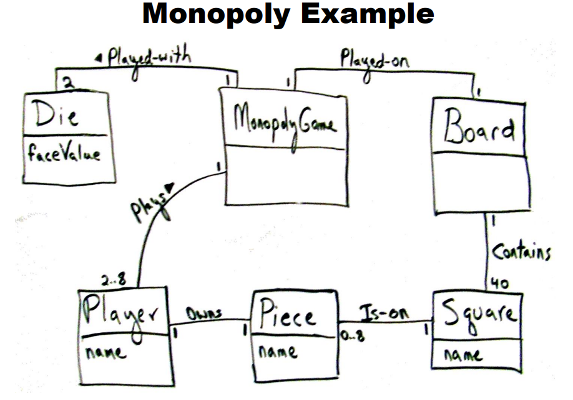
Who should get a square given a unique ID?
When you start a game, who creates the squares for the board?
1
Has
8

Slide 44
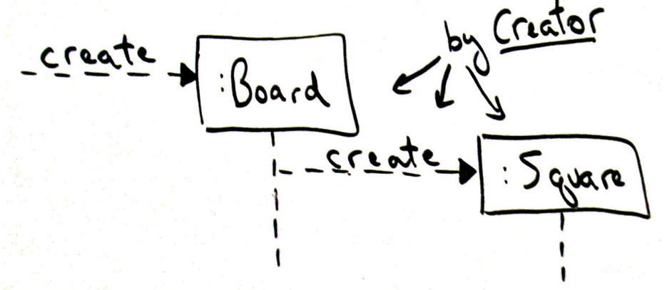
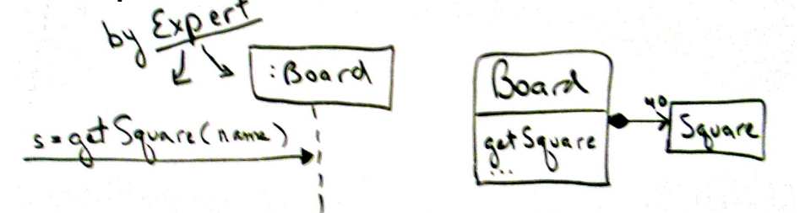

Slide 45
References
Larman, C. Applying UML and Patterns: An Introduction to Object-Oriented Analysis and Design and Iterative Development, Third Edition, Upper Saddle River, NJ: Prentice Hall PTR, 2005.

Slide 46
Poll

Slide 47


Readings , Assignments, Project Tasks
Read:
Chapters 8, 9, 10, 11, 12, 13
Assignments & Project Tasks:
Project Deliverable 2 is open (Due next Wednesday). This is a Group Submission.

Slide 48

Questions?

